Slide 1
Synchrotron Radiation
Electromagnetic Theory II
by Olga Kyzylova

Slide 2

Synchrotron Radiation
Charged particle which is moving in a curved path or is accelerating in a straight line path, emits electromagnetic radiation
Electromagnetic radiation emitted by charged particles when they are radially accelerated $\vec{v}⊥\vec{a}$ is called
for non-relativistic velocities:
Cyclotron radiation
for relativistic velocities:
Synchrotron radiation

Slide 3
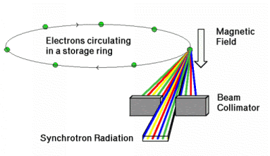
Synchrotron Radiation
Discovered in an electron synchrotron (70 MeV) in 1947 in New York
Generated by the acceleration of ultrarelativistic charged particles in a magnetic field

Slide 4












Synchrotron Radiation
$$z$$
$$r=\frac{mcv}{eB\sqrt{1−v^{2}/c^{2}}},$$
$$ω_{H}=\frac{v}{r}=\frac{eB}{mc}\sqrt{1−v^{2}/c^{2}}$$
$$I=\frac{2e^{4}B^{2}v^{2}}{3m^{2}c^{5}(1−\frac{v^{2}}{c^{2}})}$$
$$\vec{k}$$
$$θ$$
$$\vec{r}$$
$$y$$
$$φ$$
$$\vec{v}$$
$$e$$
$$\vec{B}$$
$$x$$
$\vec{k}$ - direction of radiation
$$φ=ω_{H}t$$

Slide 5

Synchrotron Radiation
Acceleration: $\vec{a}=\frac{e}{mc}\sqrt{1−\frac{v^{2}}{c^{2}}}[\vec{v}×\vec{B}]$
Average energy $dI$ per unit solid angle $do$ emitted in a one period $T=\frac{2π}{ω_{H}}$:
$$<\frac{dI}{do}>=\frac{e^{4}B^{2}v^{2}(1−\frac{v^{2}}{c^{2}})}{8π^{2}m^{2}c^{5}}\frac{\left[2−\cos^{2}θ−\frac{v^{2}}{4c^{2}}\left(1+\frac{3v^{2}}{c^{2}}\right)\cos^{4}θ\right]}{{\left(1−(\frac{v^{2}}{c^{2}})\cos^{2}θ\right)}^{7/2}}$$

Slide 6


Synchrotron Radiation
$$\frac{{\left(dI/do\right)}_{0}}{{\left(dI/do\right)}_{\frac{π}{2}}}=\frac{4+3v^{2}/c^{2}}{8(1−v^{2}/c^{2})^{5/2}}$$
In ultrarelativistic case: $v→c$ it → to ½
$$I=\frac{2e^{4}H^{2}}{3m^{2}c^{3}}{\left(\frac{E}{mc^{2}}\right)}^{2}$$
The radiation is concentrated close to the plane of orbit

Slide 7
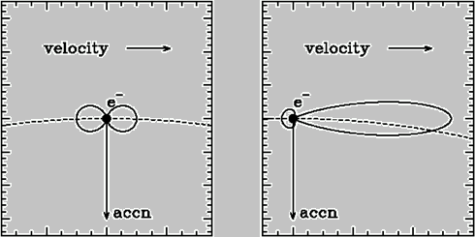

Synchrotron Beaming
Power, emitted by accelerated electron has two-lobe distribution around direction of acceleration:
$$P\left(θ\right)=P(0)\sin^{2}θ$$
Synchrotron emission beamed along direction of motion, normally to acceleration.
non-relativistic
electron
relativistic
electron

Slide 8
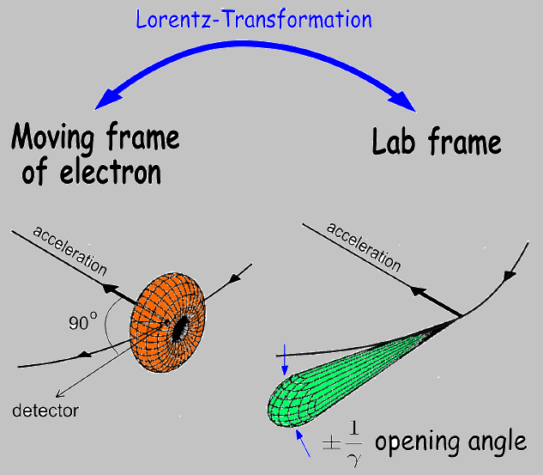
Synchrotron Beaming

Slide 9
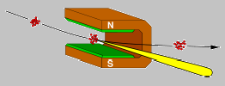
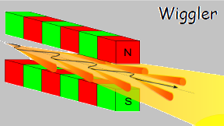
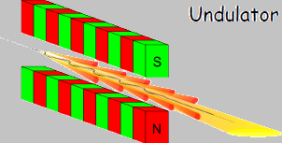

Sources of Synchrotron Radiation
Bending Magnet:
Special magnets: wigglers and undulators:
Electron beam is periodically deflected by strong bending magnets. Motion is no longer sinusoid and radiation spectrum is continuous up to a critical cutoff photon energy.
Electron beam is periodically deflected by weak sinusoidal magnetic fields. Particle emits radiation at wavelengths of periodic motion, divided by $γ^{2}$.

Slide 10
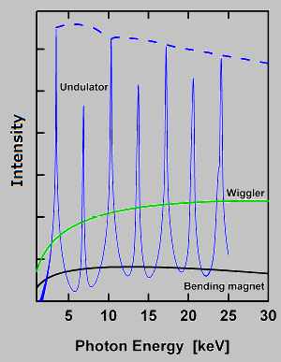



Critical Frequency
For bending magnet, energy received by an observer:
Here, radiation intensity is negligible for $ξ≫1$
Critical frequency – a frequency when $ξ=\frac{1}{2}$ and $θ=0$
For frequencies much larger than critical frequency and angles much larger than critical angle, synchrotron radiation emission is negligible.
$$ω_{C}=\frac{3}{2}\frac{c}{ρ}γ^{3}$$
$$θ_{C}≈\frac{1}{γ}{\left(\frac{2ω_{C}}{ω}\right)}^{1/3}$$

Slide 11
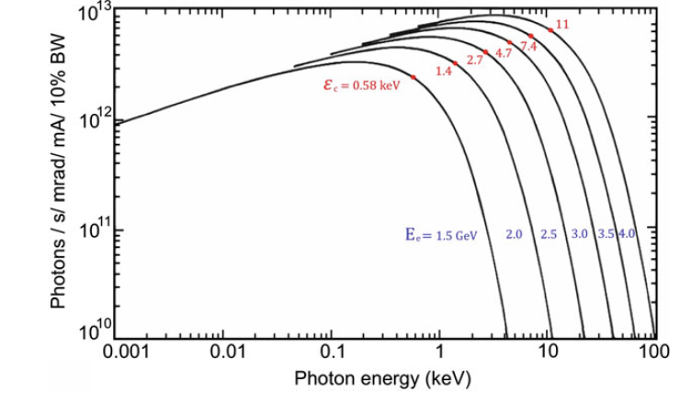
Critical Energy
Spectral distribution of synchrotron radiation as a function of a value of critical energy

Slide 12
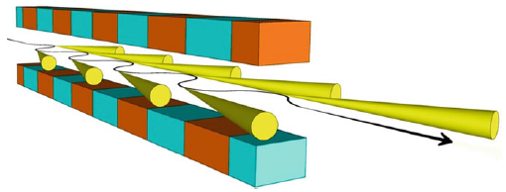
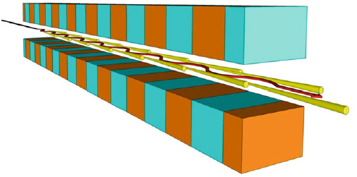
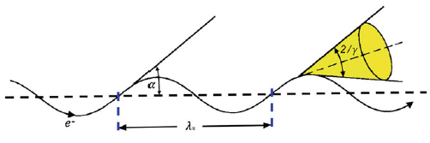
Wiggler and Undulator Magnets
Wiggler Magnet
Undulator Magnet

Slide 13
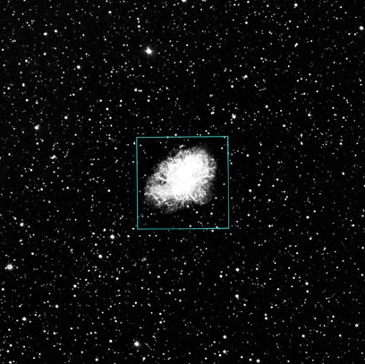
Astronomy: Crab Nebula
900 years old supernova remnant
Pulsed emission gamma radiation up to >25 GeV
Spectrum is a power law with index 0.3
Source is polarised
synchrotron emission

Slide 14
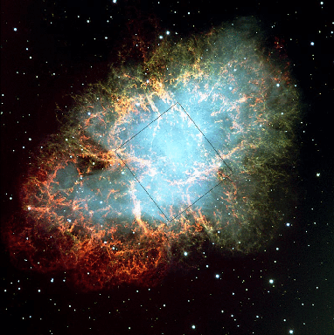
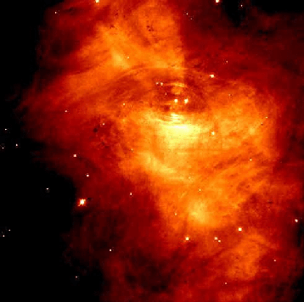
Crab Nebula
Source of electrons – central pulsar, or neutron star
In the core of Crab Nebula emission is dominated by synchrotron emission of electrons trapped in strong magneticf field around pulsar.

Slide 15
